Slide 1


Squadss:
Recommendation System.
Notes:
Fix the slide title

Slide 2
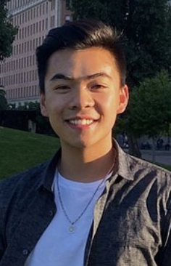


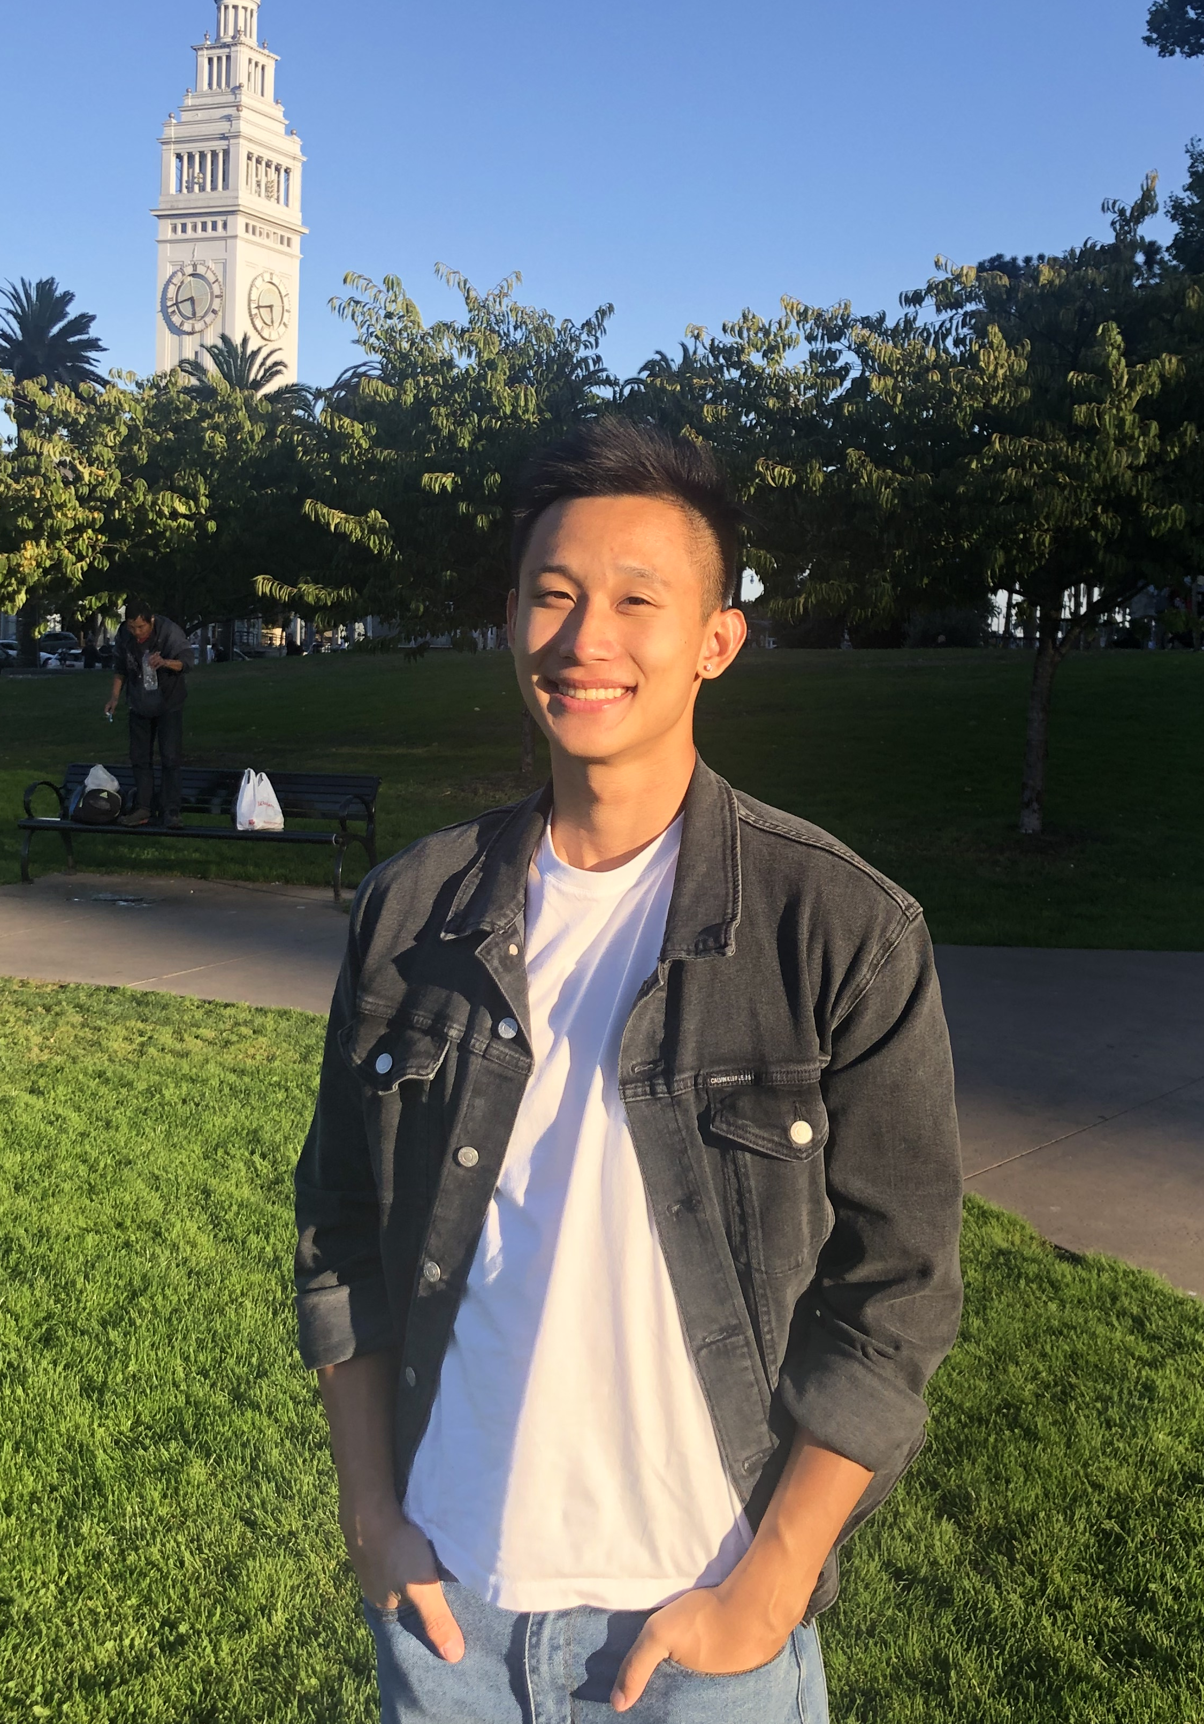
HANLIN SUN
CHRIS WANG
ANDREW ZHAO
NISHANT P.
Project Lead
SWE
SWE
SWE
Notes:
FINAL

Slide 3
Introduction
Project Background
Q: What is the underlying purpose of social media, and what value is it (supposed) to bring to our lives?
What is a question we faced?
Squadss – Our team’s vision, introduction to mobile interface, and motivation for this project.
Recommendation Systems – How is our recommendation system shine through already existing competitors in the media vertical?
Future implementations – How will this project scale in the future, and where are we looking to expand?
Introduction |Recommendation System| Future Plans
Notes:
More in depth for the 3 lines of solutions
(maybe add a sentence about each of them)

Slide 4


Squadss: Introduction

Slide 5





Why we use social media?
Content Consumption|Overview
Benefits
Social media is a convenient way for friends to stay in touch in unique and fun ways – daily pictures in snapchat, photos in Instagram, etc.
Red Flags
Teens spend on average 7 h 22 m on phone daily. Social media is intended to be a way to bring people together, not a source of superficial social validation.
Our Goal
To create a space where tight-knit friend groups can communicate, share, and call their digital home.
Introduction |Recommendation System| Future Plans
Notes:
Font uniform, flat icon above title, or instead of a title

Slide 6
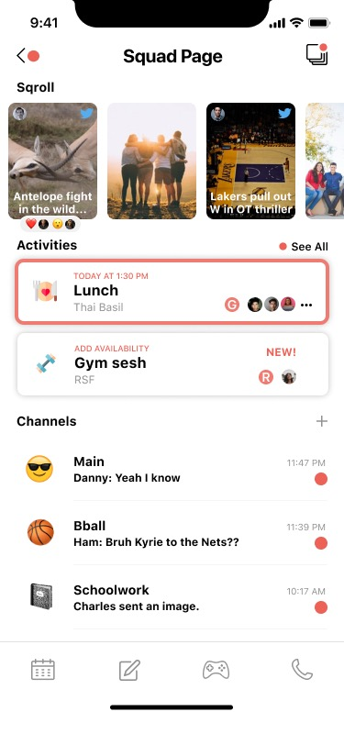
Primary Features
Overview
Squad Page: each friend group has its own unique squad page, with Sqroll, Activities, and Channels
Sqroll: a place for friend groups to share content
Activities: gCal invites are lame for friend hangouts; a place to plan activities
Channels: area for conversations, with distinct channels for different topics
Introduction |Recommendation System| Future Plans

Slide 7
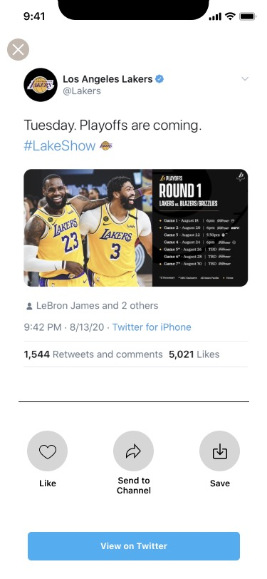
Sqroll: Recommendation System
Interactable Tweets
Motivation
You a lot more likely to watch a movie if your friends like the movie. Sqroll allows users to upload tweets to share within your group, similar to Instagram close-friends, with the exception that we will also generate personalized content based on the group’s interests
How We Provide Recommendations
Starting off, we give the user a pool of categories to select from; for example Sports, Politics, News, etc. A selection from one of the categories will lead you to tweet suggestions sorted by popularity (favorites/retweets) and popular profiles
Conclusion
At the end of the day, Tweets, TikToks, Articles are all a source of entertainment that we use to keep minds occupied. But when shared in with friends and the people close to us, they become an opportunity to create conversation and opportunity to become closer
Introduction |Recommendation System| Future Plans
Notes:
Futura font here

Slide 8
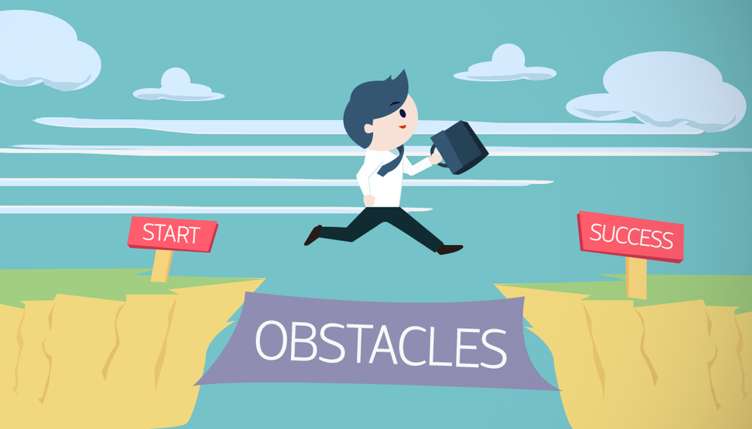

Slide 9




Scalability: Streaming vs. Pulling
Azure AD|Nike Applications
Connection to Twitter API
1
Every time we pull a tweet, a new connection must be formed between our client end and Twitter. We send a request, Twitter processes the request, and gives us a tweet. This means that for every tweet, we must send a separate request
The Problem
Twitter limits the number of requests we can send and process. This means pulling tweets is not sustainable as the number of users in our application scales. Twitter will get annoyed, stop processing our requests, and our app fails
Solution
Streaming is another way to request for tweets. Instead of establishing new connections every tweet, we establish a single connection, which constantly feeds us tweets that we cache into our database and can refer to anytime
Introduction |Recommendation System|Future Plans

Slide 10
A New Problem: Streaming
Threading | Parallel Processes
One Computer, Two Tasks
1
Because the streaming process does not end, we ran into the challenge of being unable to post-process the Tweet data… We have a function call that does not terminate. How can we continue to run new processes on our computer while still streaming? (environment diagram go brrr)
Threading
1
“Threads are a way for a program to divide itself into two or more simultaneously running tasks”
This allows us to stream and post-process together (altogether a great learning experience for all of us)
Introduction |Recommendation System| Future Plans
Notes:
Same as last time

Slide 11
Quick Demo

Slide 12


Future Plans
Overview
Need to be able to connect our backend to the mobile interface and ensure proper integration
Automate process: no more running from terminal and web browser business
Fully functional and on the app store by late January 2021
Grow, introduce this app to VCG, friends, and let the network effect do its thing
Not Just Tweets…
Connect to iOS
More than a Capstone
Expand to other media sources: TikTok, YouTube, articles via Bing, etc
Learn to adapt to user engagement data to update preferences – LensKit, ML, ALS
Introduction|Recommendation System| Future Plans
Notes:
Futura font here

Slide 13
Conclusion
Project Background
Q: What is the underlying purpose of social media, and what value is it (supposed) to bring to our lives?
What is a question we faced?
Introduction|Recommendation System| Future Plans
Notes:
More in depth for the 3 lines of solutions
(maybe add a sentence about each of them)

